Slide 1
Human Sentence Processing

Slide 2
Lexicalized Parsing
peel the apple on the towel
  ambiguous
put the apple on the towel
  put loves on (is the other reading even possible?)
    put the apple on the towel in the box
    VP[head=put] → V[head=put] NP PP
    VP[head=put] → V[head=put] NP PP[head=on]
study the apple on the towel
  study dislikes on (how can the PCFG express this?)
    VP[head=study] → VP[head=study] PP[head=on]
study it on the towel
  it dislikes on even more – PP can’t attach to pronoun

Slide 3
Lexicalized Parsing
the plan that Natasha would swallow
  ambiguous between content of plan and relative clause
the plan that Natasha would snooze
  snooze dislikes a direct object (plan)
the plan that Natasha would make
  make likes a direct object (plan)
the pill that Natasha would swallow
  pill can’t express a content-clause the way plan does
  pill is a probable direct object for swallow
How to express these distinctions in a CFG or PCFG?

Slide 4
Human Performance:
Self-Paced Reading Experiments
Pretend you’re pressing a key to get each word:
The shop sold to the bank was quite old.
We included this sentence just to distract you.
The necklace sold to the bank was quite old.
The lawyer examined by the judge was silly.
The evidence examined by the judge was silly.

Slide 5
Human Performance:
Self-Paced Reading Experiments
What happens to a self-paced reader when she goes down the garden path?
  Eventually she has to backtrack.
  That’s when she pauses: “point of disambiguation.”
  The lawyer examined by the judge ...
Why isn’t the second sentence a garden path:
  The shop sold to the bank was quite old.
  The necklace sold to the bank was quite old.
People are sensitive to frequency!

Slide 6
Big Human-Parsing Debate of the 1990’s: How Soon Does Semantics Come Into Play?
How fast is semantics? Use it constantly, or only as a last resort?
Hypothesis 1: Rely mainly on syntactic heuristics
  Get a parse this way, then interpret it semantically
  Backtrack & fix if we can’t finish the parse or it makes little semantic sense
  Sample heuristic: When you build a PP,
  attach it to the most recently built thing you can
  Sample heuristic: When an NP starts a sentence, it’s the subject
  If true, people should backtrack on “the necklace sold to the bank was …”
Hypothesis 2: Rely mainly on syntactic probabilities using head words
  Smarter version of hypothesis 1: “necklace” isn’t a common subject for “sell”
  Explains why no backtracking on “the necklace sold to the bank was …”
Hypothesis 3: Consider full semantics of a constituent as soon as it’s built
  Full interpretation as soon as we build a constituent
  So semantic analysis and backtracking are never delayed
  Garden paths result from genuinely ambiguous prefix, not slow semantics
Hypothesis 4: Consider full semantics of a constituent even before it’s built
  Start interpreting a constituent before hearing it all
  Semantics before syntax! (opposite of hypothesis 1)

Slide 7

Eye Tracking
Self-paced reading data too flaky to answer these questions.
Brain imaging is too slow and coarse.
Track people’s eye movements as they read.
  They don’t backtrack on “the necklace sold to the bank was …”
  Cleaner data; eliminates hypothesis 1.
But reading is an artificial task – people didn’t evolve to be good readers.

Slide 8
Eye Tracking
The eyes are the window to the soul.
You are constantly scanning your environment.
Why? Evolution!
highly accurate at jumping to objects
3-4 of these “saccades” per second on average
fast motion (90 degrees of arc in 100 millisec)
low latency – short wires connect eyes to brain

Slide 9
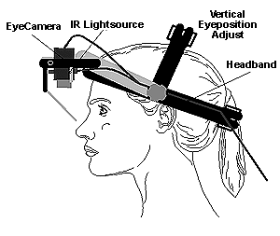
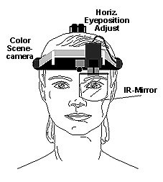
Head-Mounted Eye Tracker
Like looking into someone’s thoughts
As they happen, in a real environment!

Slide 10
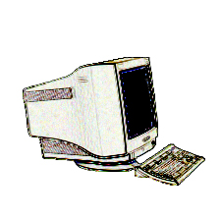
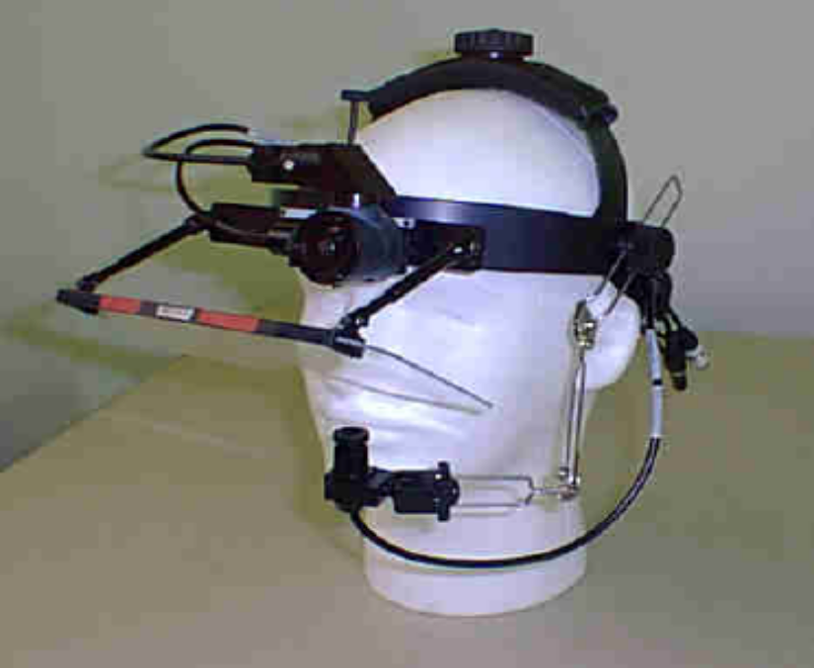
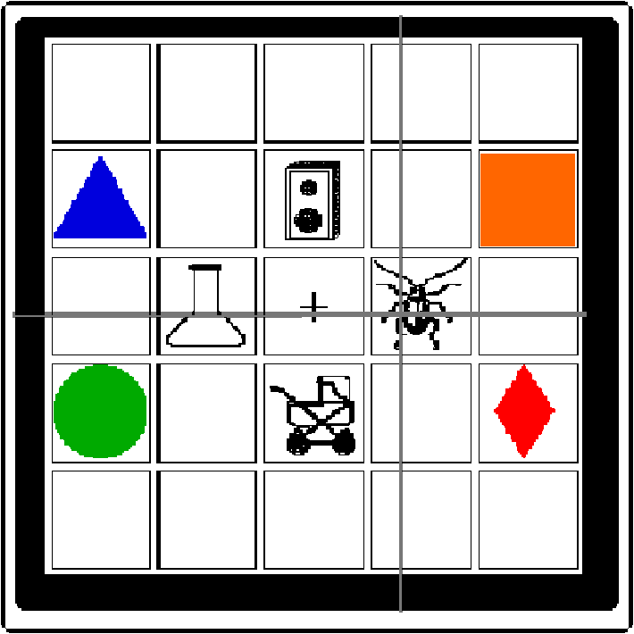
Videotape
slide courtesy of M. Tanenhaus (modified)
From Mike Tanenhaus’s lab
– University of Rochester
Eye camera
Scene camera

Slide 11

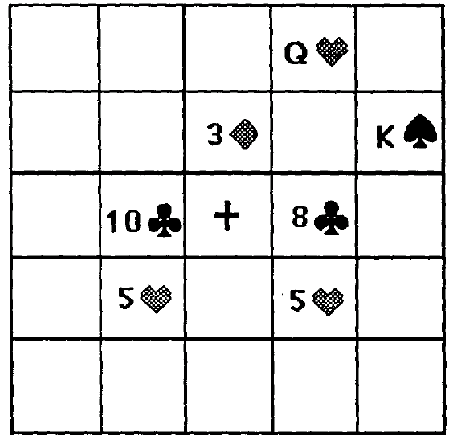
The Visual World Paradigm
(as shown on video)
look at the five of hearts
look at the other five of hearts
now put the five of hearts
that is below the eight of clubs
above the three of diamonds

total time: 4.15 seconds
Notes:
Five of hearts (look at left 5h, then right 5h, then back at left 5h) – need 3 eyes here
That is below (look at 10c, then 8c)
The eight (look at the right 5h)
Above the three (hand starts going for the right 5h)
Of dia … (start moving eyes to 3d, don’t get there on this clip)

Slide 12
The Visual World Paradigm
now put the five of hearts
that is below the eight of clubs
above the three of diamonds
Subject looks at 5♥ shortly after point of
disambiguation (underlined) – only one 5♥ below an 8
Where would point of disambiguation be
if only one of the 5♥ was below something?
What if both 5♥ were below an 8? (8♣, 8♦)

Slide 13
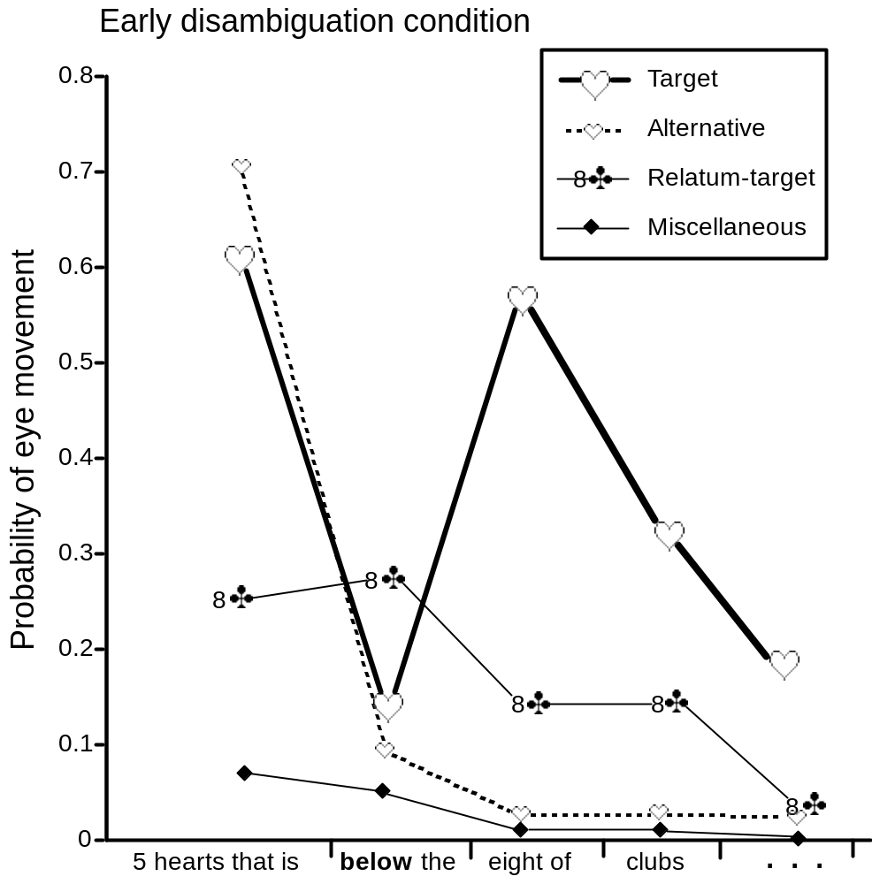
slide courtesy of M. Tanenhaus

Slide 14
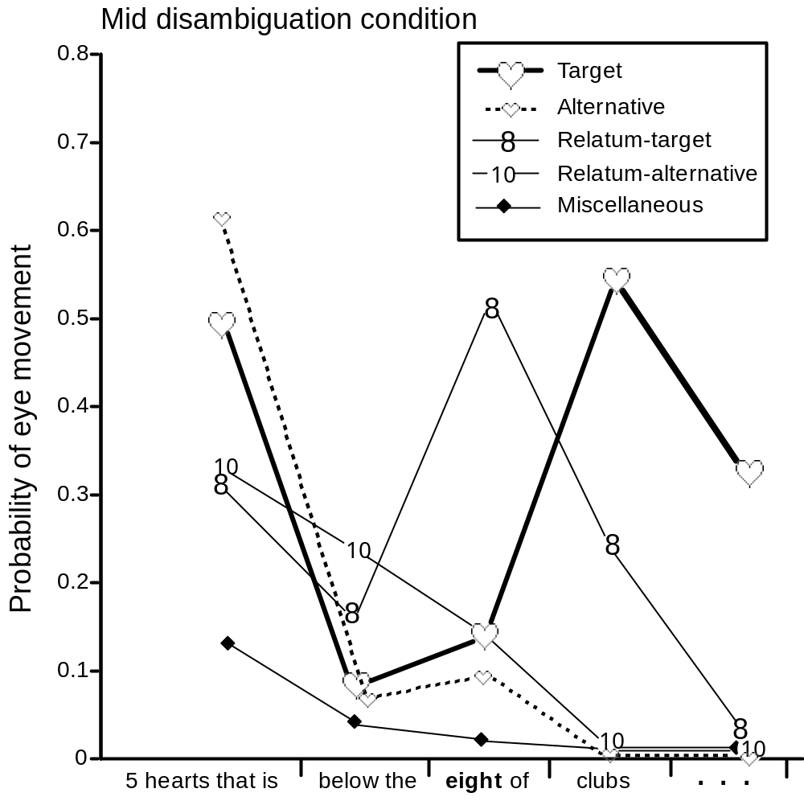
slide courtesy of M. Tanenhaus
(the video)

Slide 15
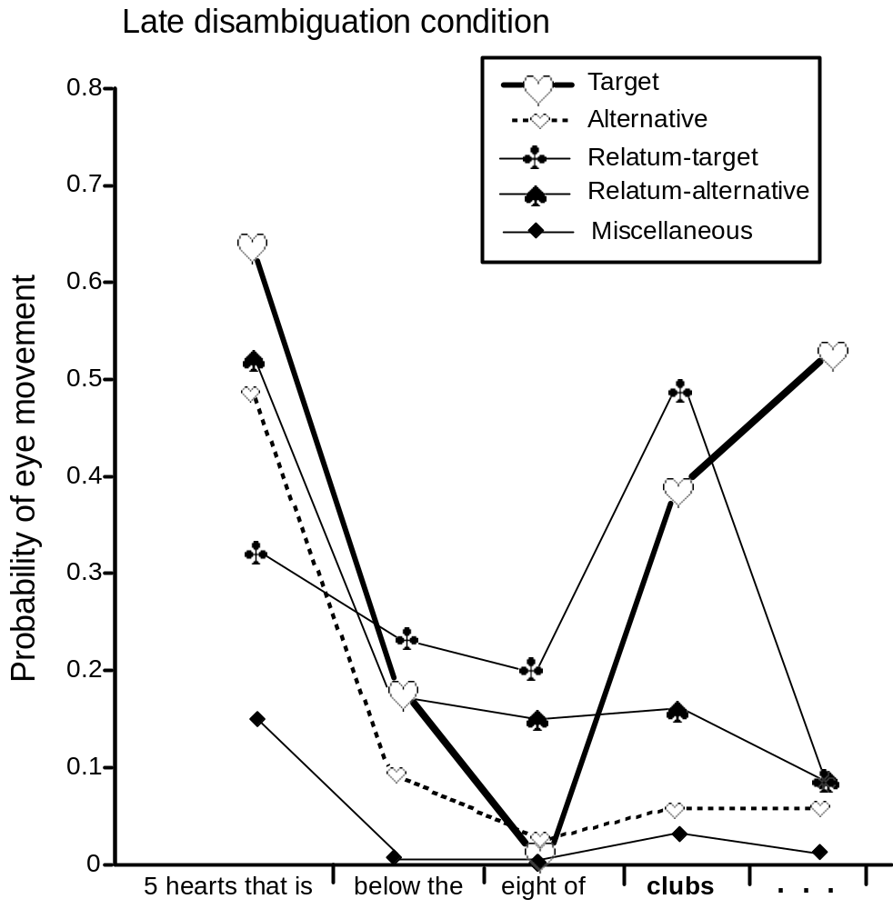
slide courtesy of M. Tanenhaus

Slide 16

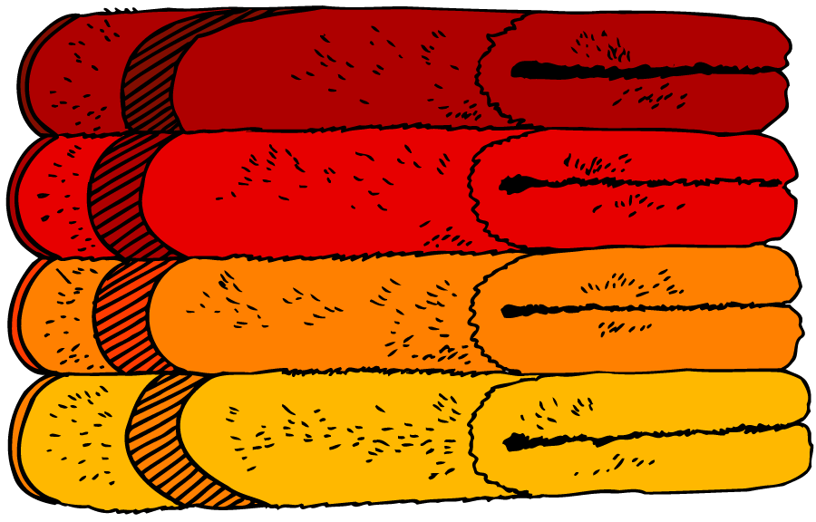
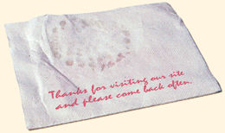
PP Attachment Ambiguity
slide courtesy of M. Tanenhaus (modified)
Put the apple on the towel in the box.
Only one apple ⇒ Garden Path
Put the apple on the towel in the box.
Two apples ⇒ use PP to clarify which apple, no garden path

Slide 17
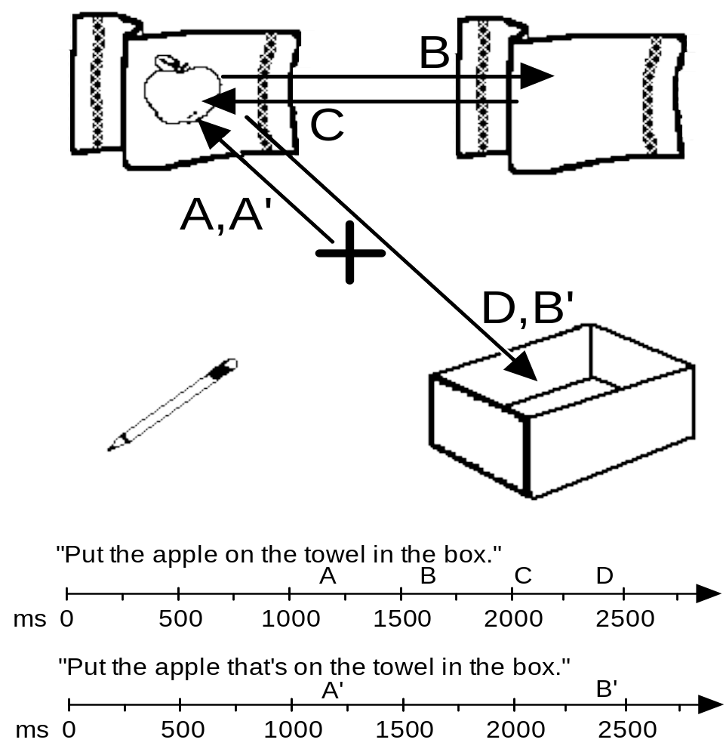
One referent context
slide courtesy of M. Tanenhaus
garden path
oops!
backtrack

Slide 18
One referent context
slide courtesy of M. Tanenhaus

Slide 19
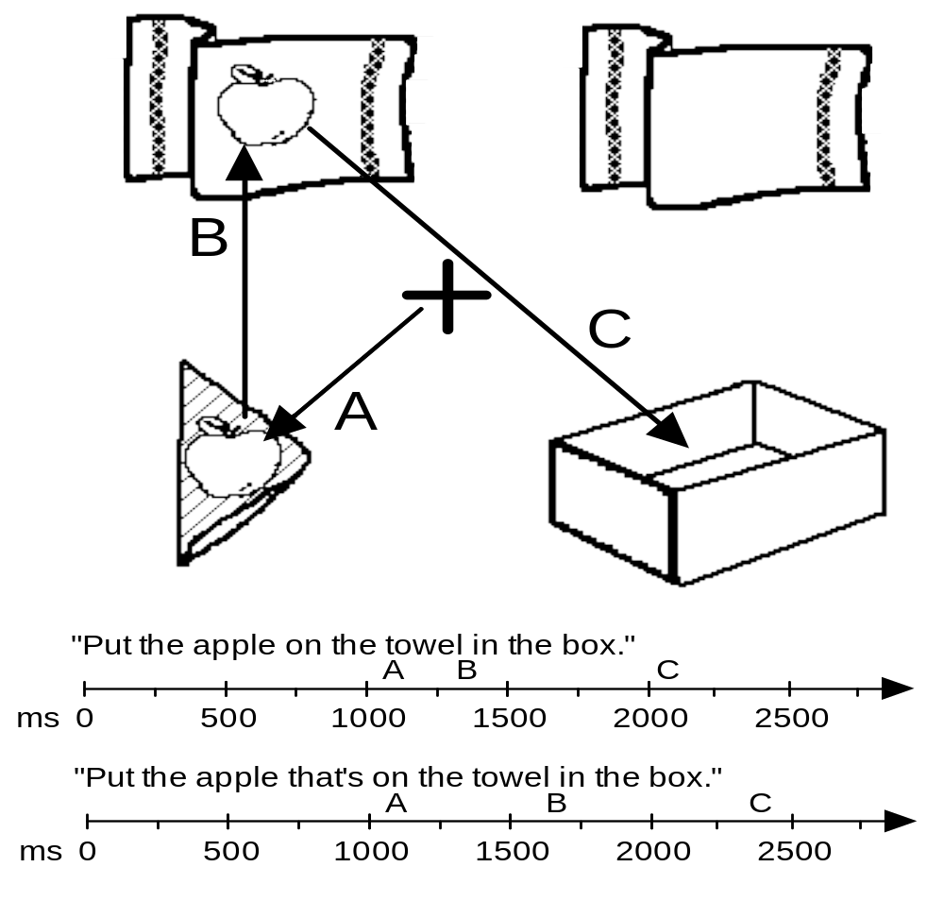
Two-referent context
slide courtesy of M. Tanenhaus
amazing
lack of
oops

Slide 20
One-Referent Context
(same picture as before – as shown on video)
Only one apple ⇒ Garden Path
put the apple on the towel in the box
put the candy bar on the saucer in the bowl
put the salt shaker on the envelope in the bowl
Notes:
Look at apple, then empty towel, then back at first apple

Slide 21
Processing at Syllable Level
Don’t wait for constituent to finish
Don’t even wait for word to finish!
pick up the candy
They’re already looking based on “can” – we know this because if there’s also a candle, they’re 50% likely to look at it first!

Slide 22
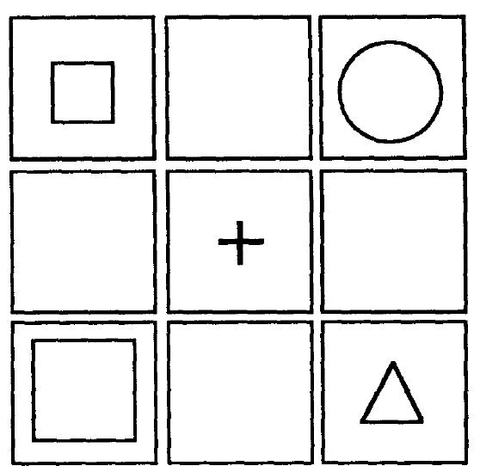
Processing Stress Information
what’s the point
of disambiguation?
Touch the large red square.
Touch the LARGE red square.

